Slide 1
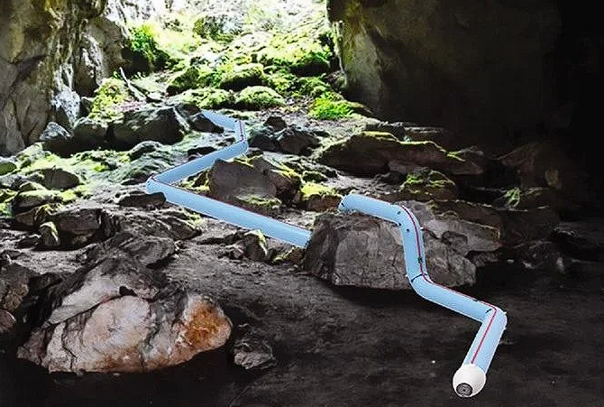
Soft Vine Robot
Group D

Slide 2
Team Members
Juan Battaglia - EE
Kevin Abreu-Aguila - CpE
Muhammad Gudaro - EE
Abdul-Malik Mustapha - EE

Slide 3
Description
Building a soft, autonomous vine robot that navigates through tight spaces
Design a user-in-the-loop system through interaction via joystick for navigation using sensory feedback
Uses a light source to guide the vine robot through a designed obstacle course
Uses pneumatically controlled tubing to navigate turns, tight areas, rough terrain, and elevations

Slide 4
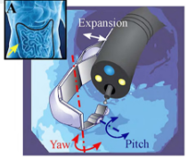
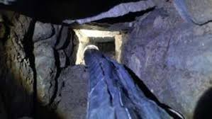
Motivation
We asked ourselves two questions:
What if nature and other animals can contribute to the advancement of robotics?
How do we create a device that can go through hard-to-reach places?
Soft robotics aims to operate where regular robots cannot
Archeological studies require assistance to navigate small ducts
Object retrieval and delivery during disasters
Medical robots must operate in delicate environments

Slide 5
Project Constraints
Economic and Environmental
Parts not available and budget is very high for expensive parts
We are the sole financiers of this project
Pandemic
Time and Educational
Other responsibilities(i.e other classes, internships and part-time jobs)
Never done a project at this magnitude( Developing new and complex designs)
Safety
Soldering components on the PCB
High pneumatic pressure can cause things to explode

Slide 6
Project Goals and Objectives
Goals
Design a soft robot using flexible material such as LDPE poly tubing
Programmed to navigate through an obstacle course
Pneumatically controlled tubing will be used to make turns through the course
Manual user interface
Interact with an object at the end of the obstacle course
Stretch Goals
Gripper system
allows the worm robot to pick up objects.
requires a cap that allows for switching between the mounted camera and the grippers.
Autonomous Mode
use Computer Vision to allow the robot to make steering decisions.
Allows the robot to track an object or light bulb.

Slide 7
Project Specifications

Slide 8
Division of labor

Slide 9
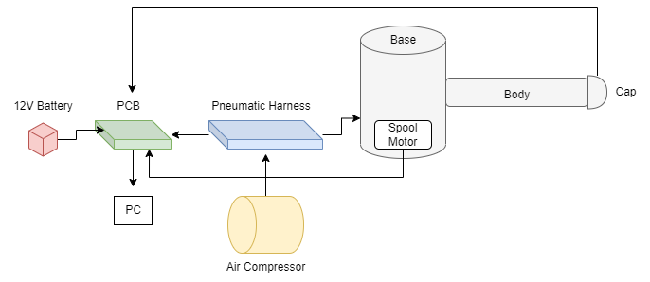
Design Overview
High Level Design Overview

Slide 10
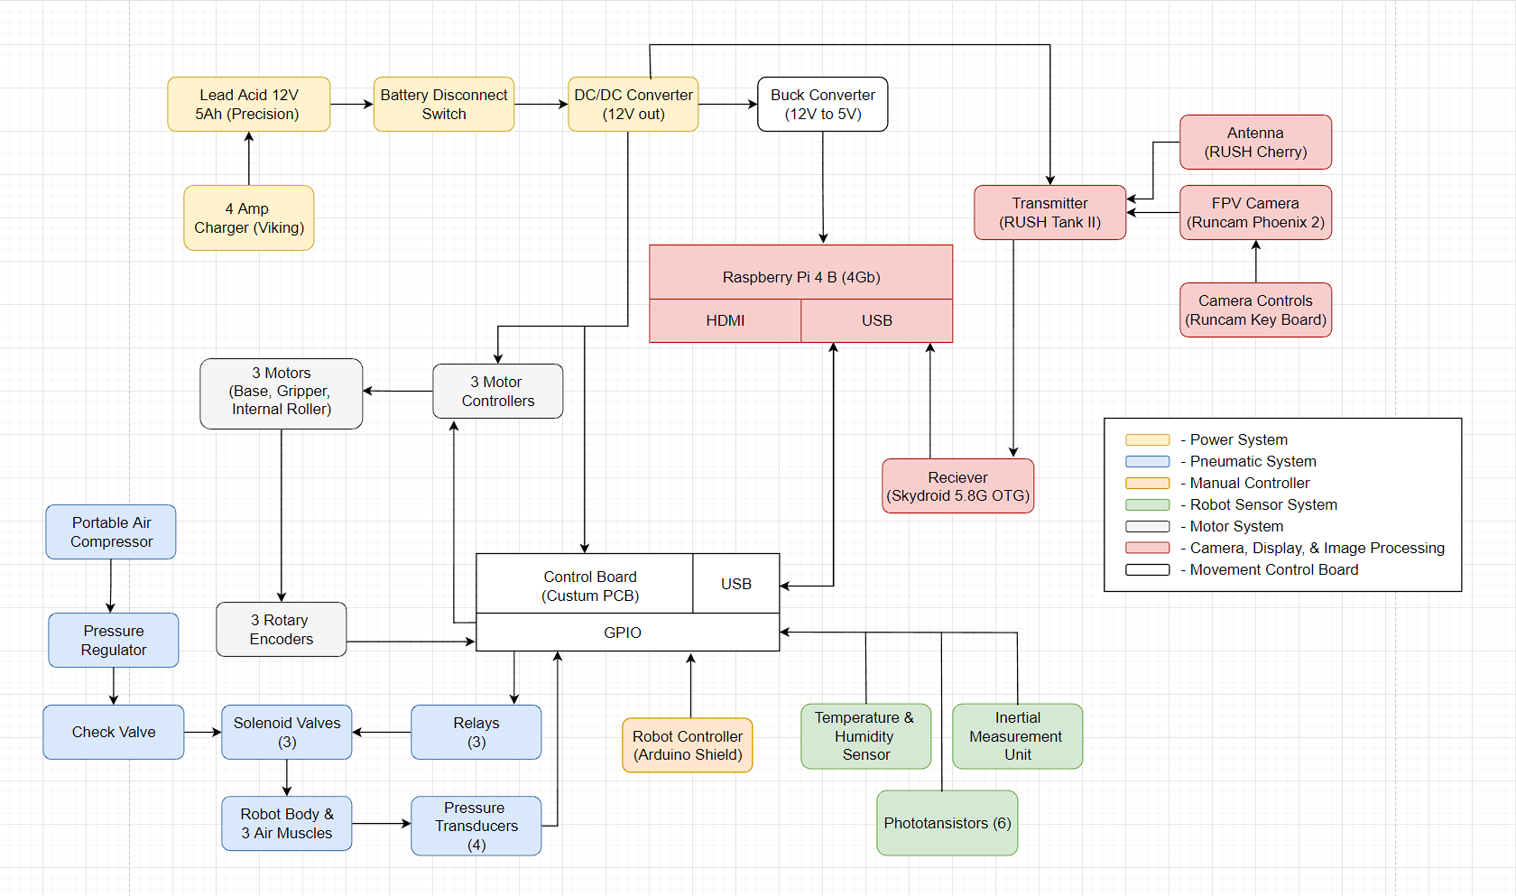
Overall Block Diagram

Slide 11
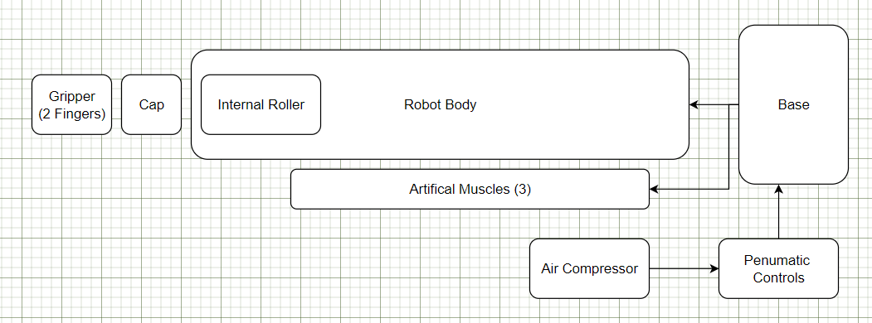
Mechanical Design - Overview
Robot Body
Lengthens through eversion
Artificial Muscles (sPAMs)
Steer robot using series pouches
Robot Base
Houses robot and controls lengthening speed
Internal Roller
Allows robot to retract
Tip-Mounted Cap
Houses sensors and effectors
Pneumatics Controls
Regulate the contraction & expansion of robot

Slide 12
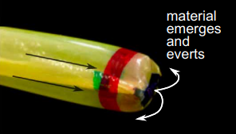
Mechanical Design - Body
LDPE Poly Tubing
Flexible but not stretchable material
3.18” in diameter
Bursting pressure: 3.2 PSI
Robot body will unspool from the base and evert at the tip using the encouragement of air pressure
Minimum growth pressure: 0.9 PSI
Max speed: 2 in/s
Base spool motor and solenoid valve must be in sync for the robot to evert smoothly

Slide 13
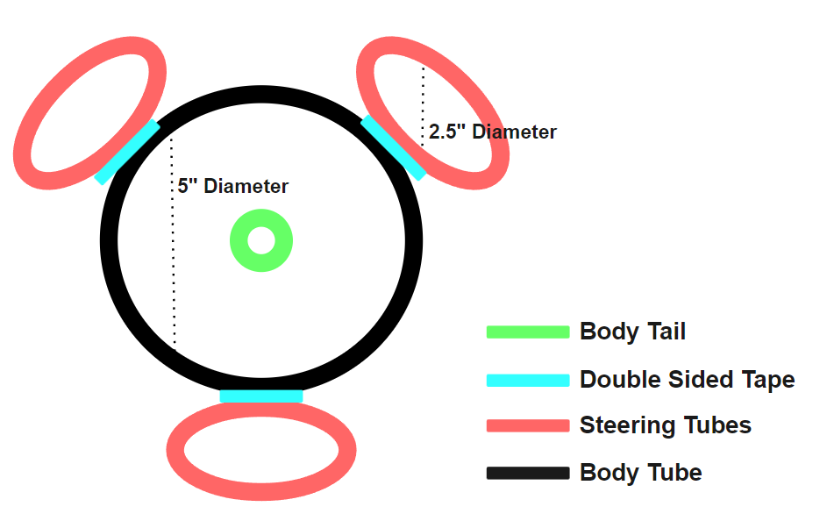
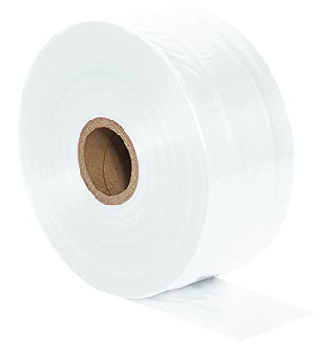
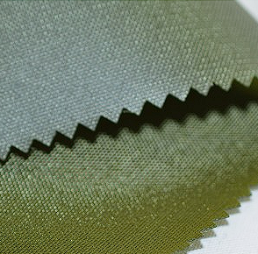
Mechanical Design - Body
There are two different materials that are flexible but not stretchable and easily formable into a vine robot
LDPE plastic is cheaper than Nylon fabrics and has the benefit of already being formed into a tube
LDPE is also thinner and lighter which decreases the pressure needed to lengthen and steer the robot
The benefit of the more durable nylon fabric is not directly applicable to our goals
We wanted the thinnest possible robot for pneumatic purposes
The size was chosen by analyzing common sizes of vine robots among research labs
The cap was subsequently sized for our robot

Slide 14
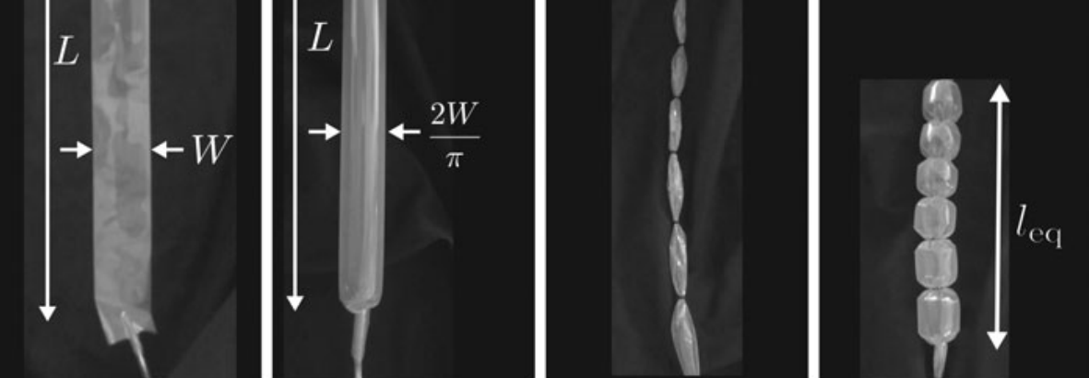
Mechanical Design - sPAMs
Series Pneumatic Artificial Muscles (pouch motors)
O-rings spaced 1.5” apart will create series pouch motors (1.59” diameter)
Three of these sPAMs will be attaches, equidistant from each other around the body of the robot
sPAMs contract when pressurized
Using this mechanic we can steer the robot by pressurizing the sPAMs of the desired direction
Pressure within the sPAMs will be regulated by quickly switching the solenoid valves on and off

Slide 15
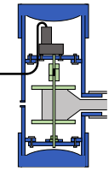
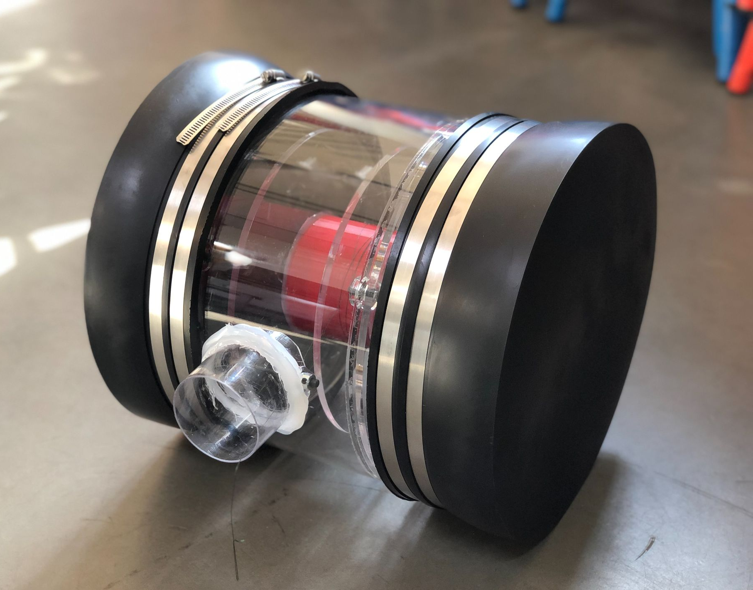
Mechanical Design - Base
The base will be a pressurized chamber with a motor controlled spool inside of it
The appropriate pressure will be fed into the chamber via an external air supply
As the pressure increases the motor will allow the spool to unroll, and the robot will evert and lengthen
The base will use Quik caps to maintain an airtight seal

Slide 16
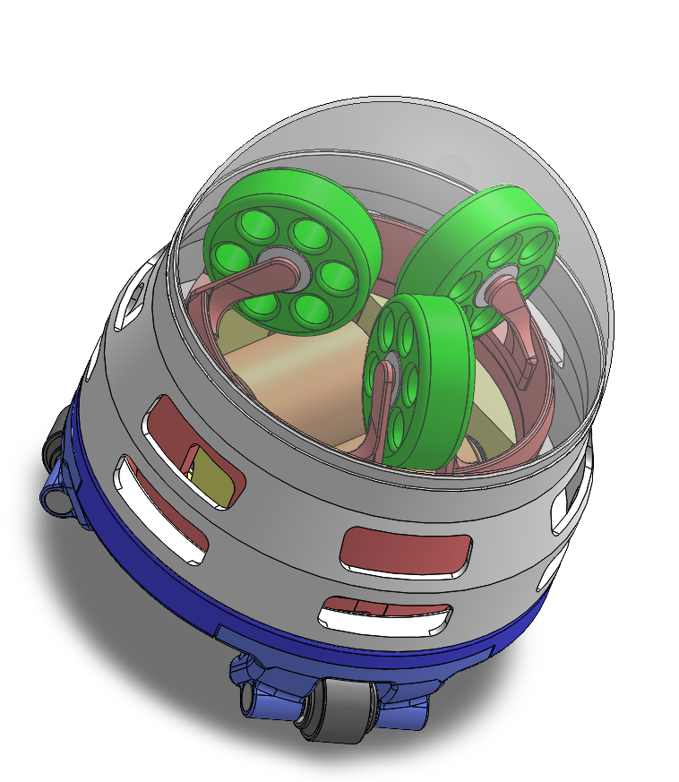
Mechanical Design - Cap
Made mostly of 3D printed materials
The cap provides a solid surface to place our sensors and tip mounted hardware
The design integrates the camera mount and retraction device into a single assembly
The green rollers guide the robot body back towards the retraction device which has a high friction coefficient to grip onto the robot
The magnet array allow the entire assembly to hold onto the soft robot body

Slide 17
Mechanical Design - Retraction
When pulling the robot back from the base it has the possibility of buckling due to the curves the robot is subjected to while lengthening
A retraction device incorporated at the tip overcomes the buckling issue by retracting from the same angle that the robot is facing at all times
Two motors will drive two high friction rollers to usher the robot back into itself
Simultaneously, the base spool will roll up the robot body

Slide 18
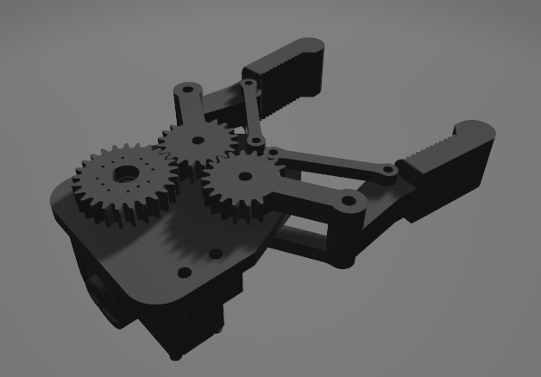
Mechanical Design - Gripper
The currently designed gripper will attach to the tip cap and will actuate two fingers
The servo used to actuate the gripper will have wires running through the center of the everting robot and towards the control board and base
Gripper will have a opening diameter of ~4”

Slide 19
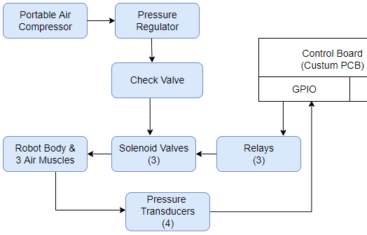
Mechanical Design - Pneumatics
A pressure regulator will ensure that we never surpass 4 PSI
We will need around 10 CFM at 3 PSI to reach our desired speed of 2in/s
Check valves will assure that air doesn’t flow backwards
The relays will open and close the solenoid valves to allow for granular control of the pressure within each tube
Pressure transducers will allow us to receive feedback on the current pressure of each tube

Slide 20
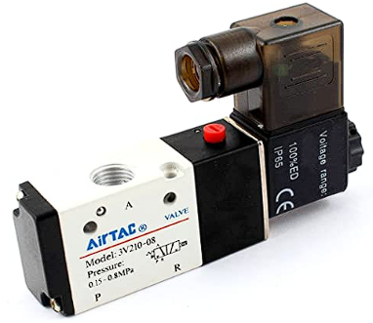
Mechanical Design - Pneumatics
Our solenoid valves allow us to electrically control the opening and closing of pressure valves in our robot
By quickly opening and closing the solenoid valve we can control the air flow into and out of our robot
The Woljay 3V10-08 was the cheapest 3 way 2 position solenoid valve that had a relatively low PSI threshold
The mac PSI large enough to be safe for our applications

Slide 21
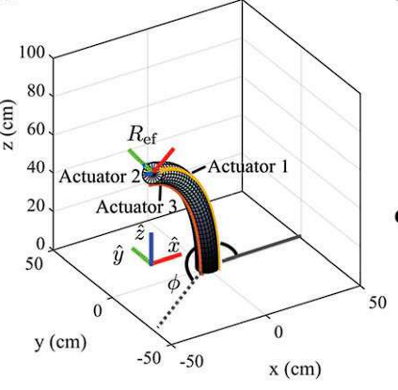
Mechanical Design - Steering Mechanics
Given the three steering muscles, turning in any one direction may seem confusing
Imagine the tip of the robot as drawing on a 2D plane
The theta angles represent the positioning of the muscles on the robot body
Plugging target coordinates into the x and y will give us a target summation of pressures necessary to reach that coordinate
Next we assume that one of the muscles has a pressure of zero and solve for the other two pressures
The c constant will allow us to account for different tube sizes

Slide 22
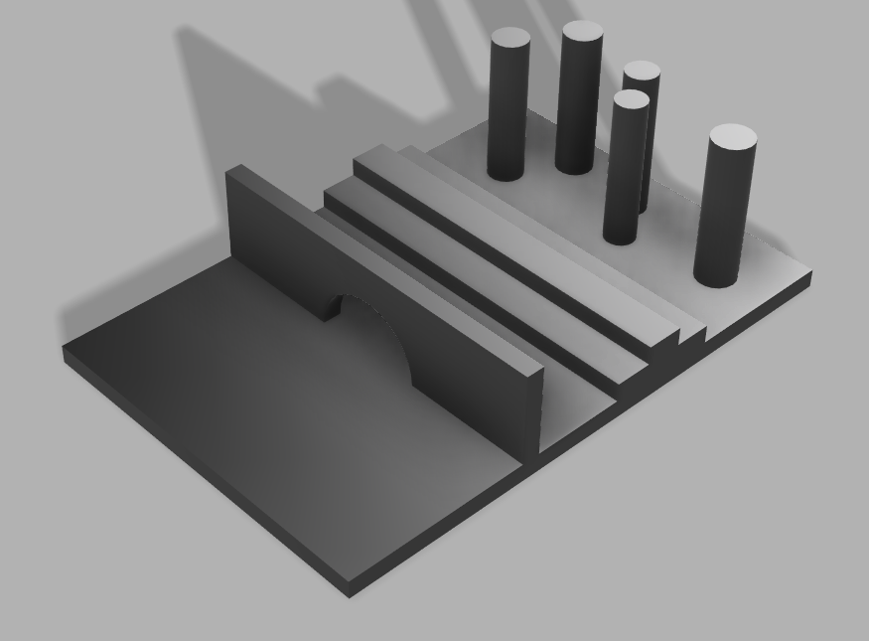
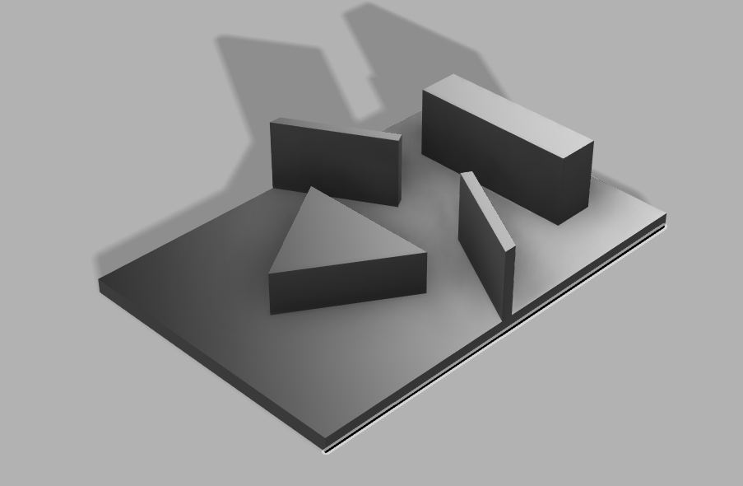
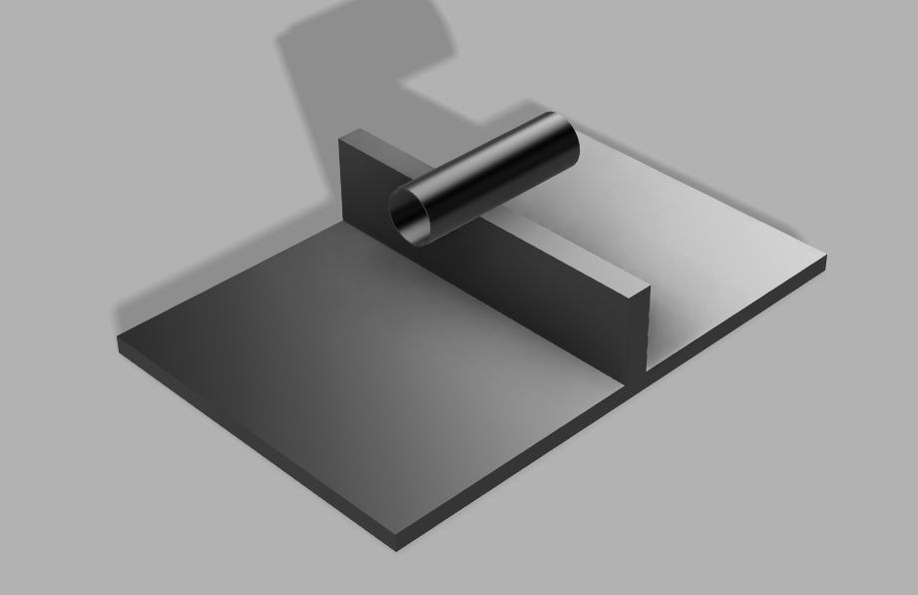
Mechanical Design - Obstacle Course
We have designed a total of 3 different obstacle courses
Each tests different motions of the robot
Made from 2 sheets of 4’x4’ plywood attached together using hinges
The obstacles made with styrofoam velcroed onto the plywood panels
Allow us to quickly switch out obstacles and create different course layouts
Allow the course to be more portable

Slide 23
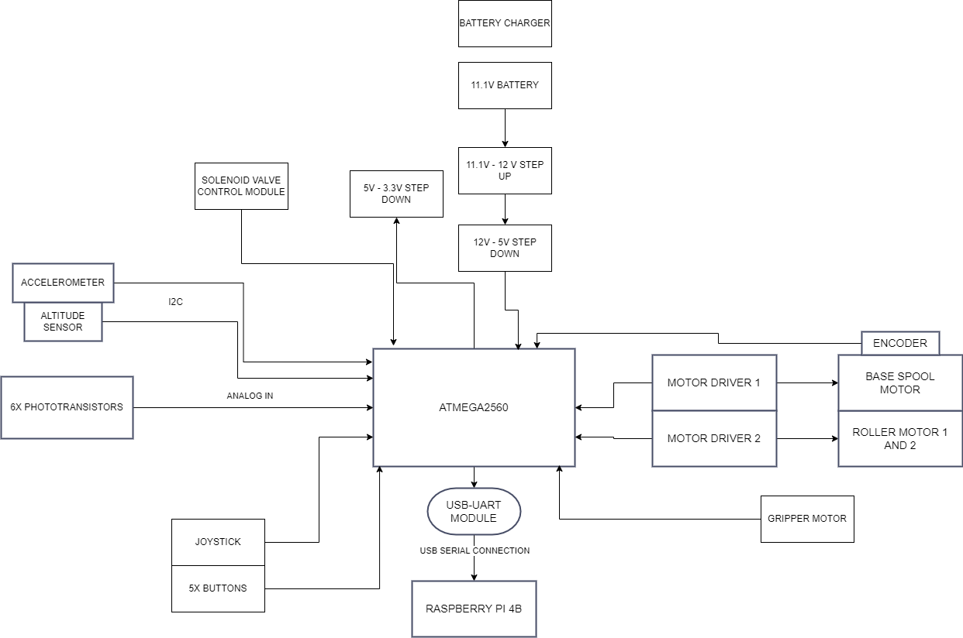
Hardware Design - Design Overview

Slide 24
Hardware Design - Microcontroller
ATmega2560
Includes enough digital/analog inputs
PWM outputs
I2C, SPI, UART
Feature | ATmega328 | ATmega2560 | Raspberry Pi 4B
Memory | 32 KB | 256 KB | 4 GB RAM
Clock Speed | 16 MHz | 16 MHz | 1.5 GHz
Operating Voltage | 5V | 5V | 4.75 to 5.25
Digital I/O Pins | 14 | 54 | 26
Analog Pins | 6 | 16 | 0
PWM Pins | 6 | 15 | 4
Operating System | N/A | N/A | Raspbian Linux

Slide 25
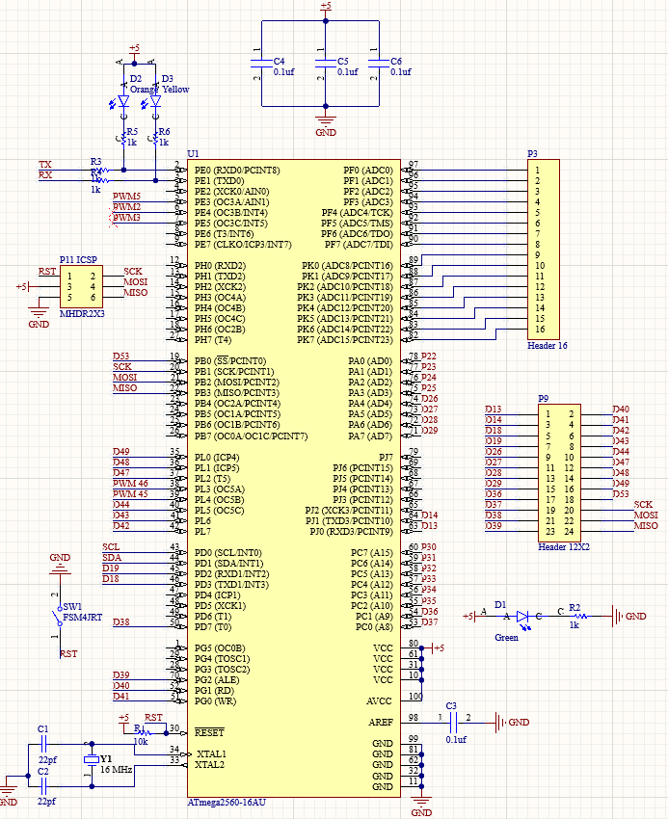
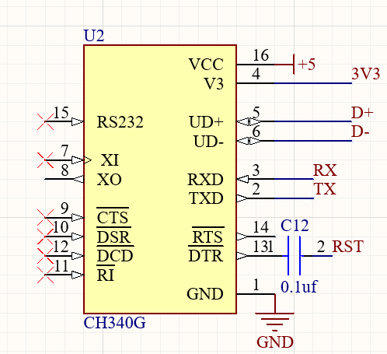
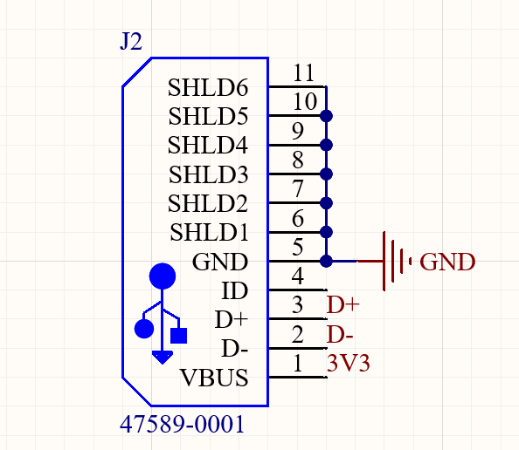
Hardware Design - Microcontroller Schematic
ICSP programming interface
LEDs for power, serial
Reset switch
Bypass capacitors
Headers for digital/analog pins
USB serial interface with CH340G and 47589-0001 micro usb

Slide 26
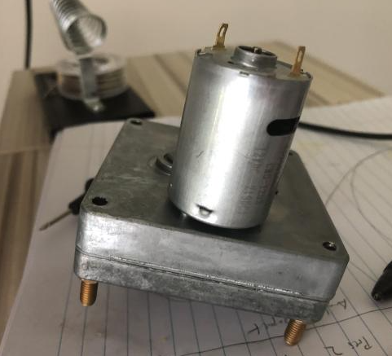
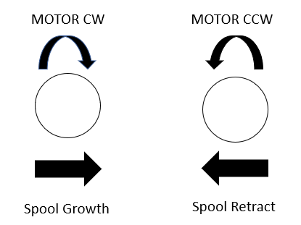
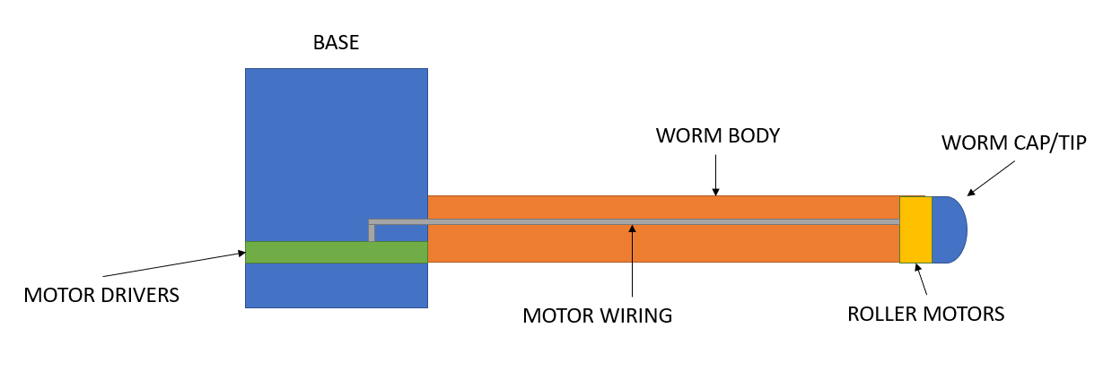
Hardware Design - Motors / Motor Driver
12VDC Squareface Gearmotor
Base motor - Drives spool
2x Metal Gearmotor
Roller motors
SG90 Servo Motor
Gripper
L293 Motor Driver
Used to drive the 3 gearmotors
Motor Encoder
Used to detect motor position
BASE MOTOR
GRIPPER
GRIPPER MOTOR

Slide 27
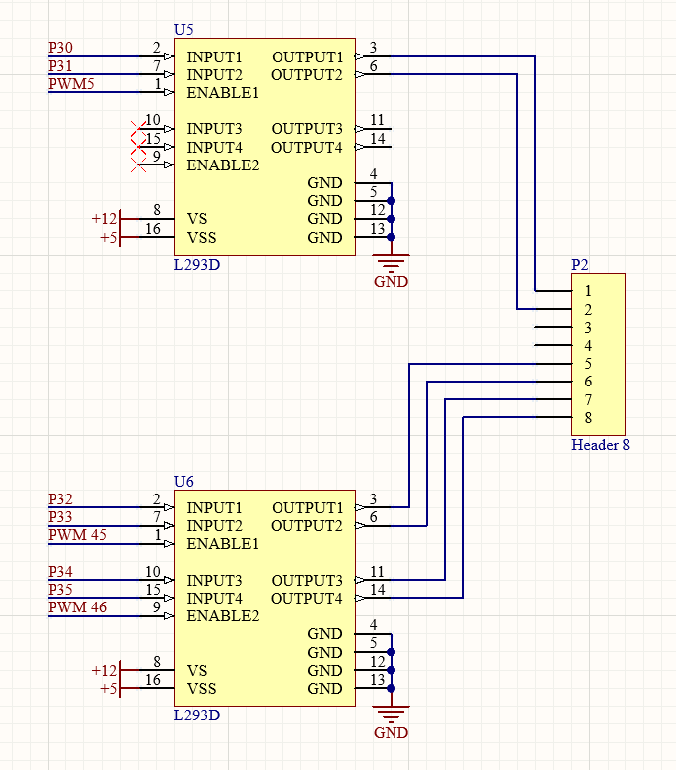
Hardware Design - Motor Schematic
Pins to interface with encoders

Slide 28
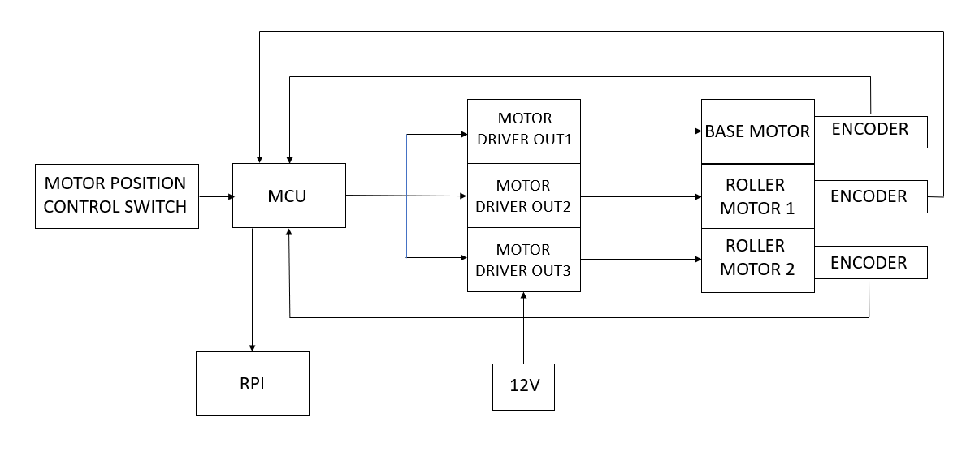
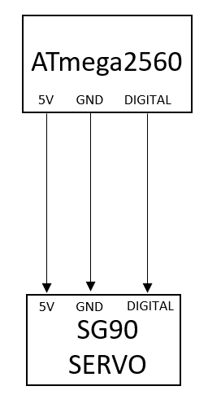
Hardware Design - Motor Design Block Diagram

Slide 29
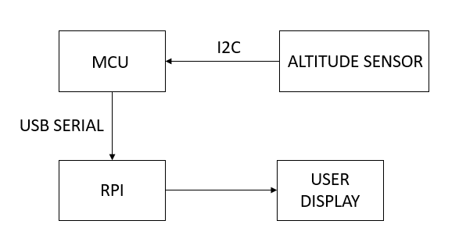
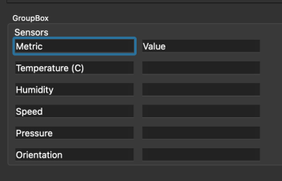
Hardware Design - Altitude Sensor
MPL3115A2
Sends Altitude data to Atmega2560, which then sends it to Raspberry Pi over USB serial to be displayed on GUI
Placed on worm cap
Parameter | Value
Supply Voltage | 1.62V - 3.6V
Operating Voltage | 1.95V - 3.6V
Serial Interfaces | I2C
Integrated Current | 40 uA
SCL Clock Frequency | 400 kHz
Operating Temperature (°C) | -40 - 85
Current Consumption | 2 mA

Slide 30
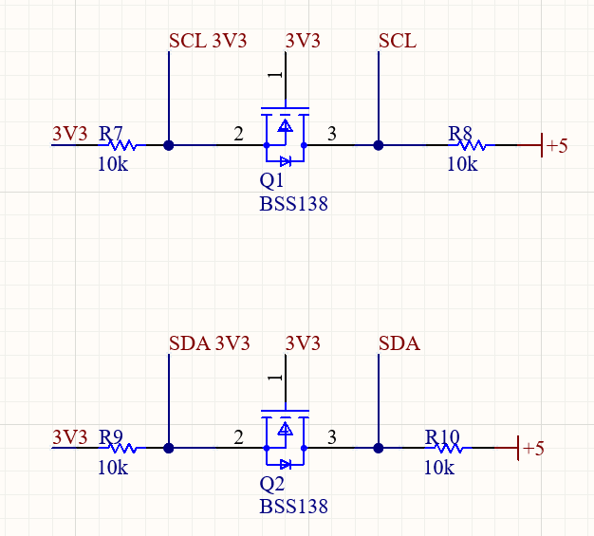
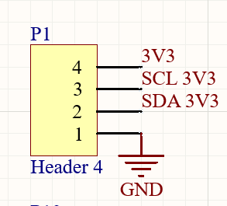
Hardware Design - Logic Level Conversion
Atmega2560 is a 5V device so the 3.3V Altitude sensor requires level conversion
Used BSS138 N-channel FET
I2C pins converted to 3.3V
PCB has outputs for SDA, SCL, and 3.3V for sensor to interface with

Slide 31
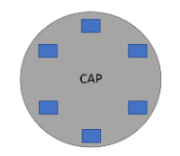
Hardware Design - Autonomous Navigation
Phototransistors
Will be used to return light data to the Raspberry Pi, which will assist with autonomously following the light
USB Camera
RunCam Phoenix 2 Micro Camera to give live video feed to the user, a video feed that will be processed using OpenCV
Worm Cap with Phototransistors Depicted in Blue

Slide 32
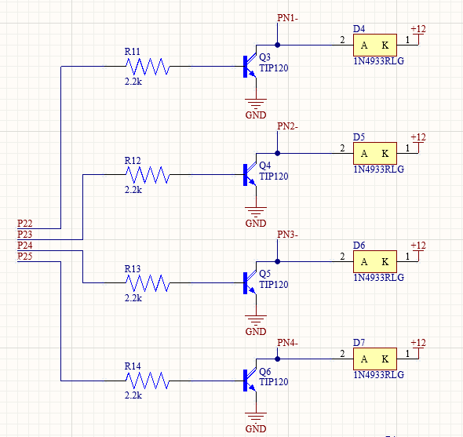
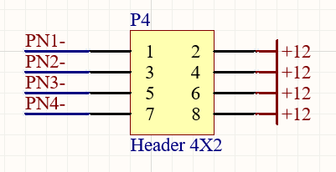
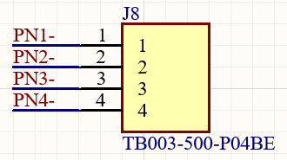
Hardware Design - Pneumatic Control
Worm will have 4 pneumatics used to inflate and deflate the tubes.
A controller circuit is designed to control the solenoids and pneumatics
TIP120 darlington transistors are used to control the current flow to the 12V solenoids
TIP120, 2.2k resistor, 1N4933RLG diode
Digital high will complete the circuit, turning on solenoid

Slide 33
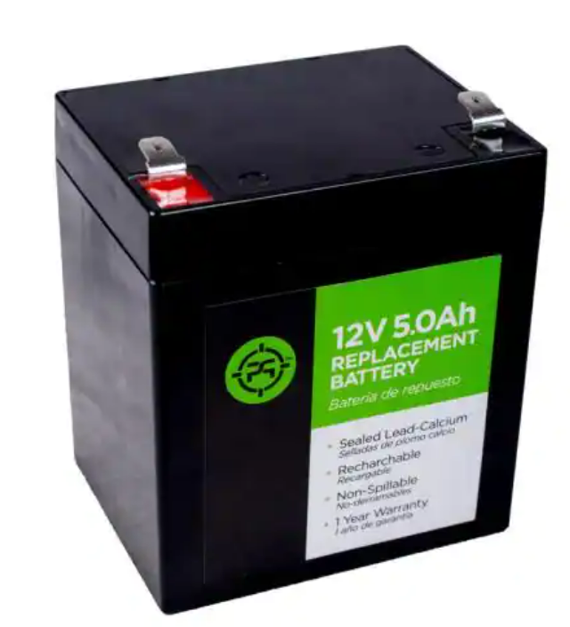
Battery

Slide 34
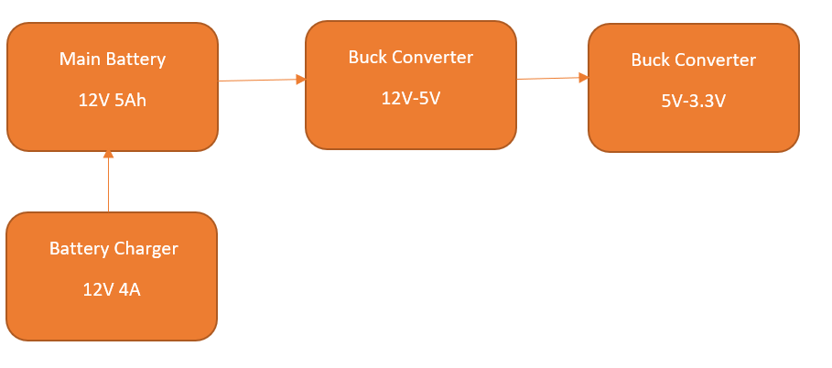
Power Design Block Diagram
Will power the robot using a 12V car battery which will be charged by a 4 amp car battery charger.
The 12V power will step down to 5V to power the raspberry pi and atmega and a 5V steps down to a 3.3V to power our altitude sensor.

Slide 35
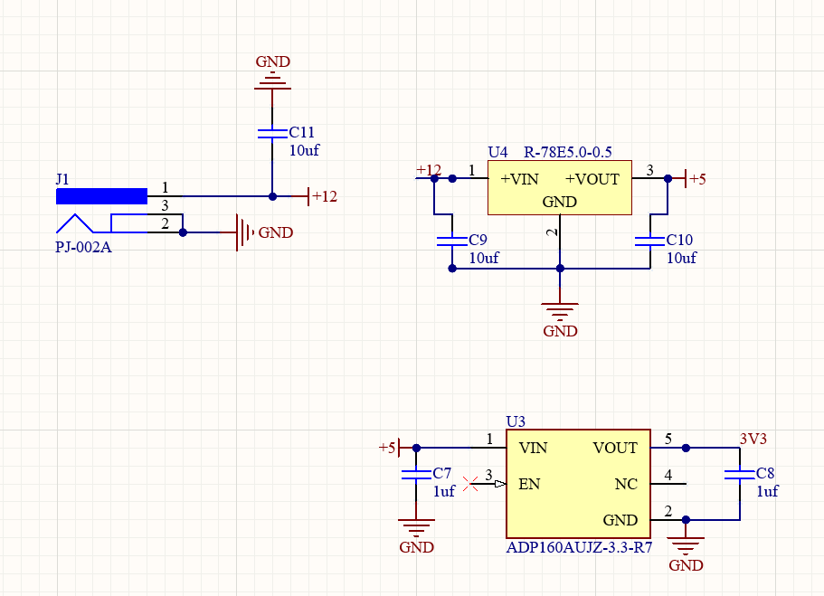
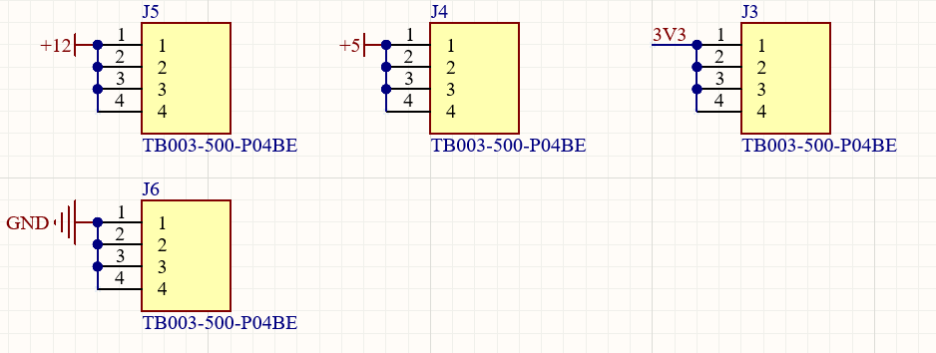
Hardware Design - Power Conversion
PCB takes 7-28VDC, converts to 12V, 5V, 3.3V
12V used to power motors and pneumatics
5V used to power MCU
3.3V used to power altitude sensor
PJ-002A Power jack for power input
ADP160 for 5V to 3.3V
R-78E5 for 7-28V to 12V
Added extra power outputs with TB003 terminal blocks

Slide 36
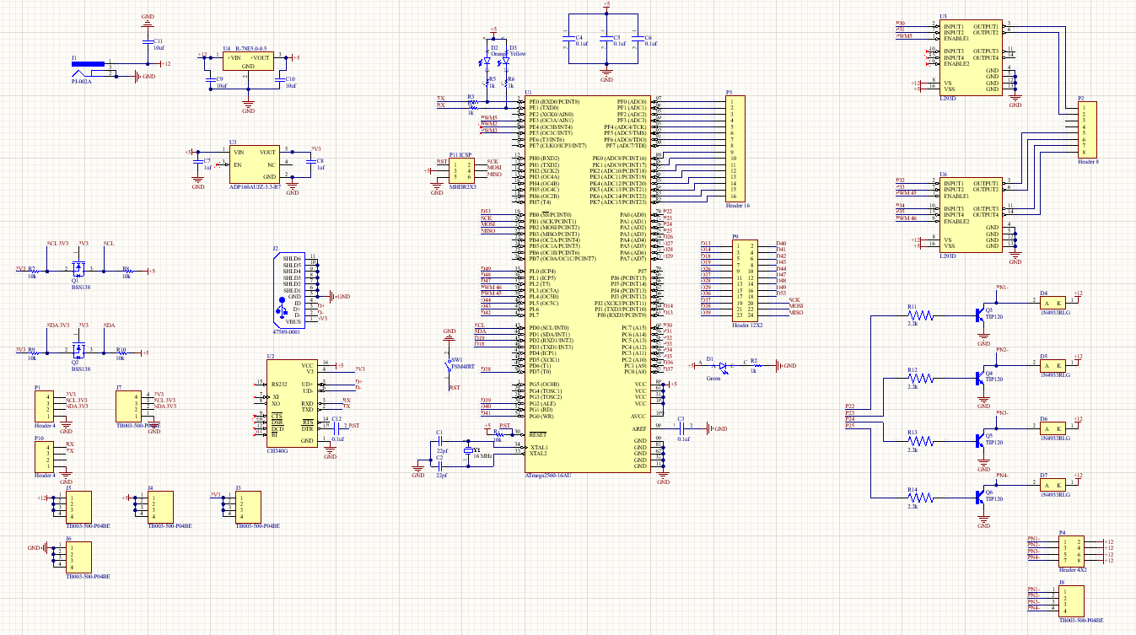
Hardware Design - PCB Schematic
Includes integrated schematics for all hardware, located at base of worm

Slide 37
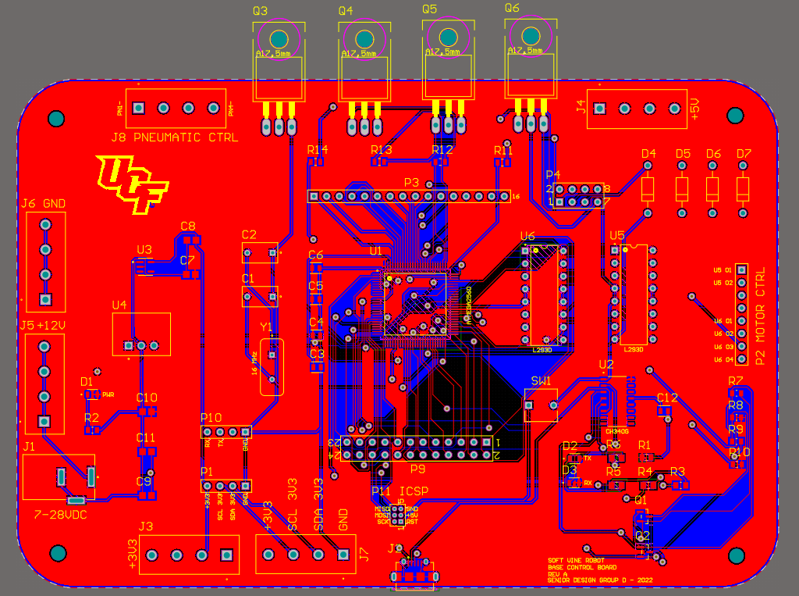
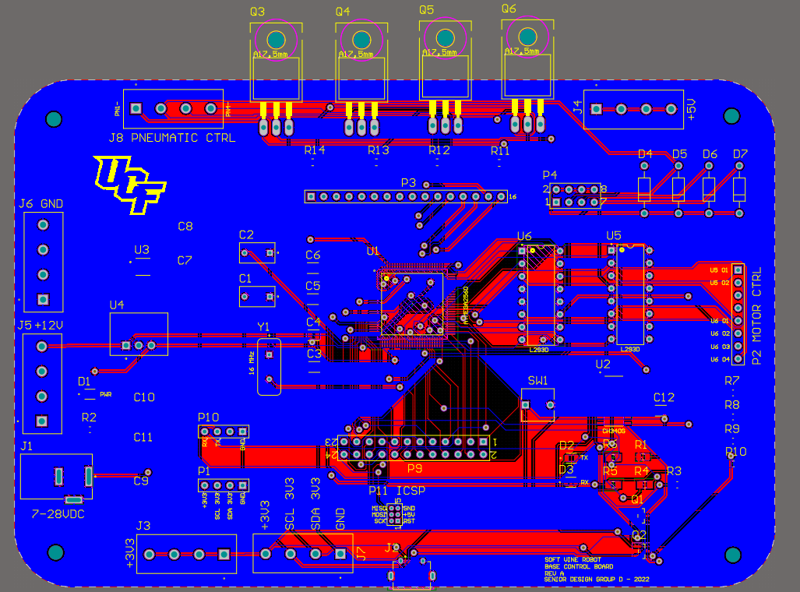
Hardware Design - PCB Layout

Slide 38
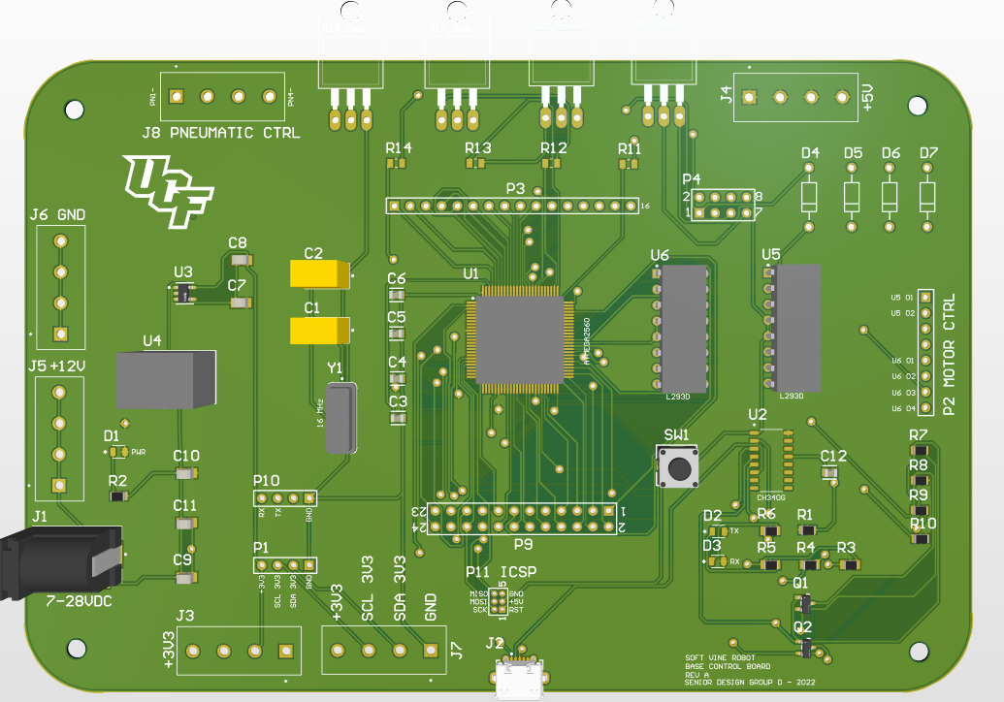
Hardware Design - PCB 3D Model

Slide 39
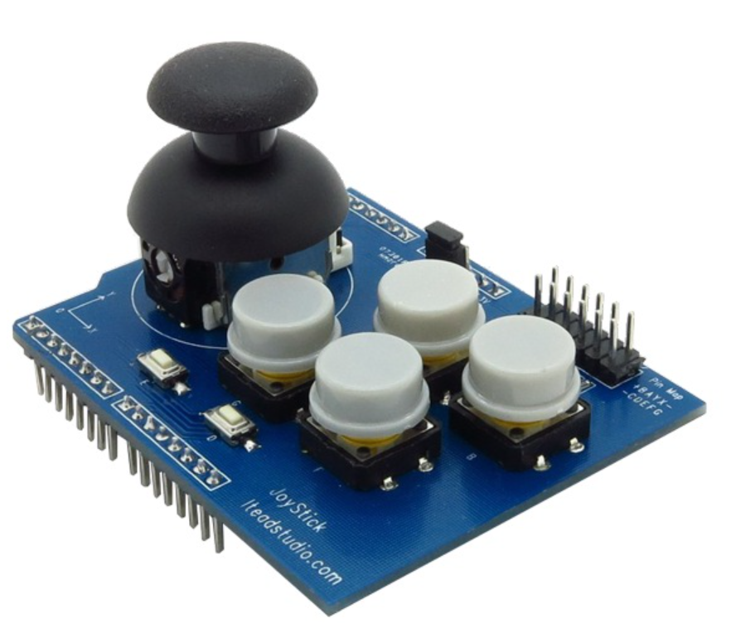
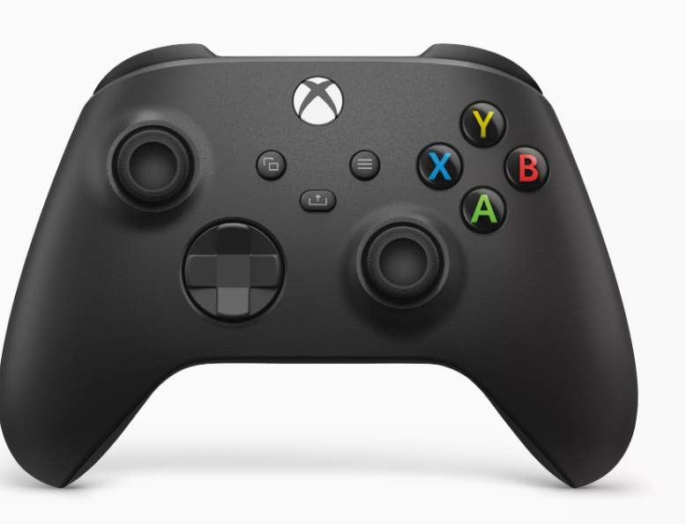
Controller Board

Slide 40
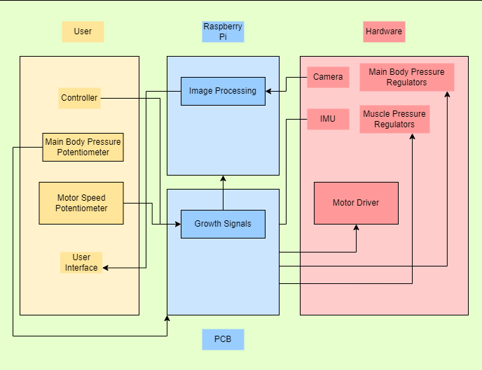
Software Design
Overall Diagram
Facilitates communication between project components
Allows User Interaction and feedback from sensors
Handles Computer Vision aspect for autonomous navigation

Slide 41
User Interface
Implemented using PyQt Python Framework
Presents user with live feedback from all sensors
Uses feedback from camera so the user can navigate
Allows mode switching between manual and autonomous mode

Slide 42
Manual vs Autonomous Mode
Manual Mode:
Joystick controller sends signals to PCB board which controls pneumatics and motors
Sensors interact with the Raspberry Pi to report information back to the UI

Slide 43
Manual vs Autonomous Mode
Autonomous Mode:
Raspberry Pi handles heavy CV computation
PCB gets the growth signal from algorithm and controls motors and pneumatics
Sensors and camera send feedback to UI

Slide 44
Computer Vision
Boosting Tracker | Based on the AdaBoost ML algorithm. Trained at runtime. Takes time to learn the positive and negative examples of the object. Generally, really slow since it is over a decade old.
CSRT | Trains correlation filters with compressed features. Slower than KCF algorithms, very robust to unpredictable motion. Recovers from failures not including failures from total object occlusion.
KCF | Trains a filter with patches containing the object and nearby patches. Faster than CRST, adapts to scale and rotation, does not recover well from failures or total object occlusion.
TLD | Trains a classifier used to re-detect the object and correct tracking errors. Recovers from full occlusion, adapts to scale and deformation. Reports lots of false positives, does not report failures.
MedianFlow | Tracks both forward and backward displacement of objects, measures the difference between the trajectories. Good at reporting failures but it can fail if there is a quick change in motion.

Slide 45
Computer Vision
OpenCV focuses on Image Processing, Video Capturing, and analysis including Face Detection and Object Detection.
Cross-platform open-source library that provides tools for any kind of image and video processing.
Important modules: .imgproc, .video, .Videoio and .imgcodecs.

Slide 46
Object Tracking
Will implement an a frame-related grid that allows the tracking algorithm to determine which way the robot should move so the object is centered and reachable

Slide 47
Sensor Signal Transmission
The sensor data will be received and sent among the PCBs via I2C
Transmission data will be transferred among all PCBs all the way to the UI
Controller signals will be received by main PCB and used for motor and pneumatic control

Slide 48
Testing
Motor testing
Breadboard prototyping/testing with Atmega2560 and L293 motor driver to control motors
Pneumatic testing
Breadboard prototyping/testing with Atmega2560 and TIP120 transistor to control pneumatic
Bursting pressures and max turning radius
Airtight seal of the base
CFM at each PSI characterization
Mechanical Testing
Retraction and spool synchronization
Gripper servo tactile strength (water bottle test)
Software Testing
Image processing using camera
UI test with PyAutoGUI
Sensor Testing
Altitude, pressure, and phototransistor testing with Atmega2560

Slide 49
PCB Testing with Breadboard and Arduino Uno

Slide 50
Motor testing

Slide 51
Testing serial communication

Slide 52
Budget

Slide 53
Timeline

Slide 54
Progress

Slide 55
Successes Difficulties
We have ordered almost all parts
Significant PCB design is complete
STL files are ready to print, but 3D printer requires maintenance first
Laser cutter files are ready to cut, but we are waiting on acrylic order
We went with a pre-made joystick in order to save time and money
LiPo battery was too expensive, so we found alternative Lead-acid battery
Managing opportunity cost of some features
Pneumatic design is largely untested at the moments and may require an increase in budgeting

